Slide 2
Contents
Ⅰ
Itda Farm, A Mobile Marketplace
Ⅱ
Background
Ⅲ
Activities
Ⅳ
Challenges and Tasks

Slide 3
Ⅰ. Itda Farm, A Mobile Marketplace

Slide 4
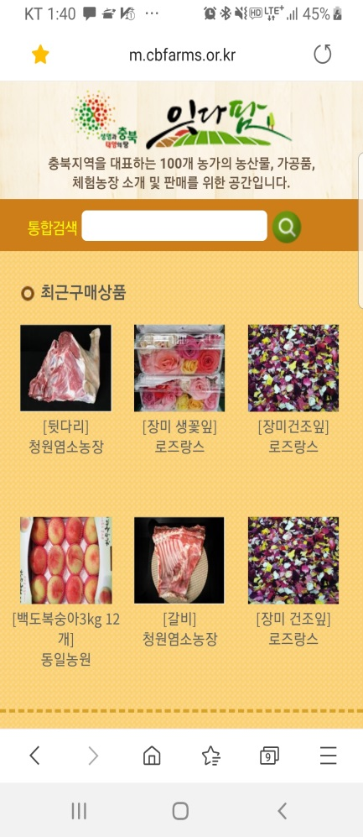
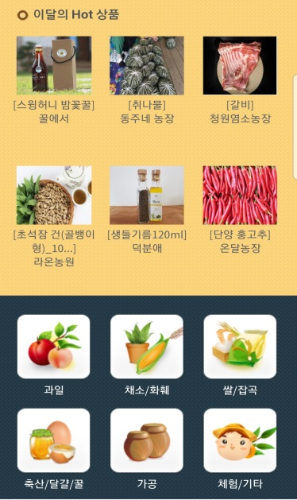
Ⅰ. Itdafarm, A Mobile Marketplace
Overview
Participats: 117 farm households in Chungbuk
Service started: January 4, 2015
Business: farm introduction, farm stories, product sales, SNS activities
Main activities: Forming and operating social media supporters and autonomy committee
http://m.cbfarms.or.kr
※ Brand meaning: linking producers and consumers

Slide 5
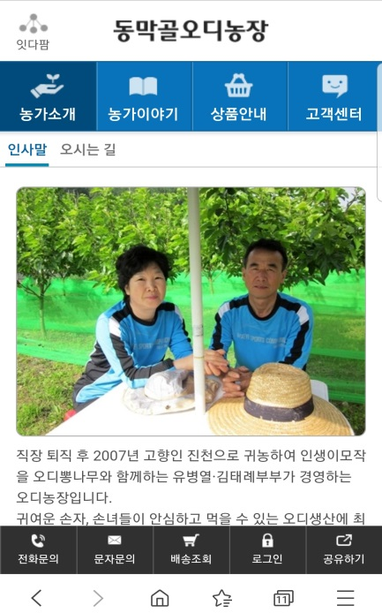
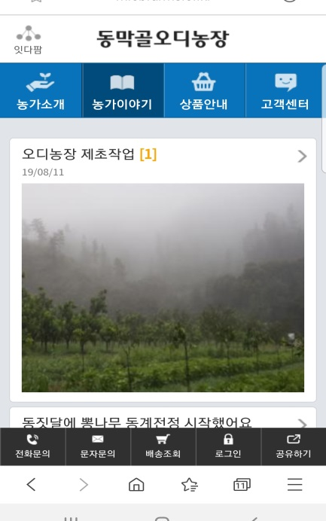
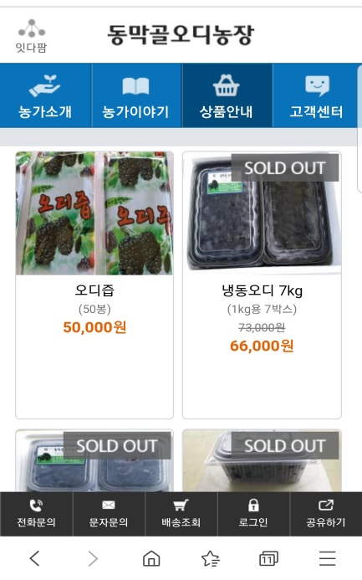
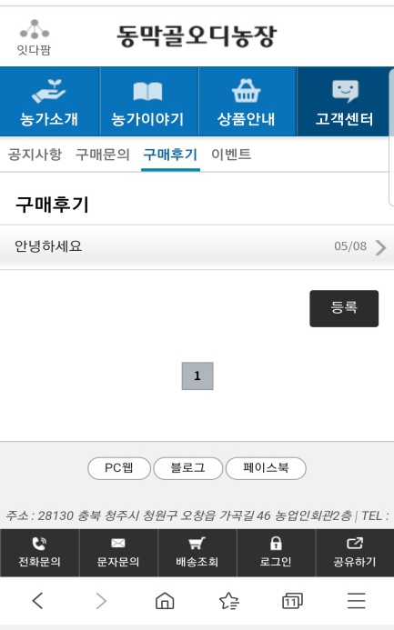
Shopping Mall Design by Farm

Slide 6
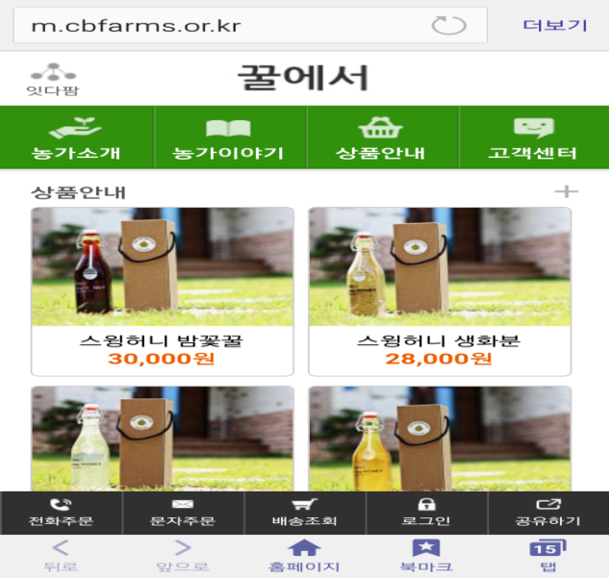
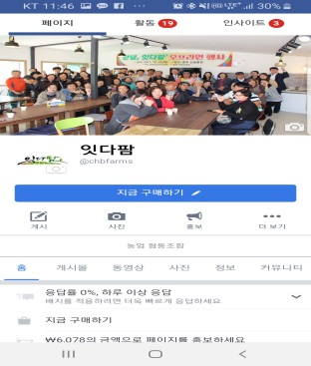
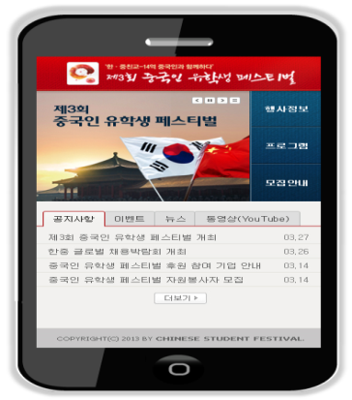
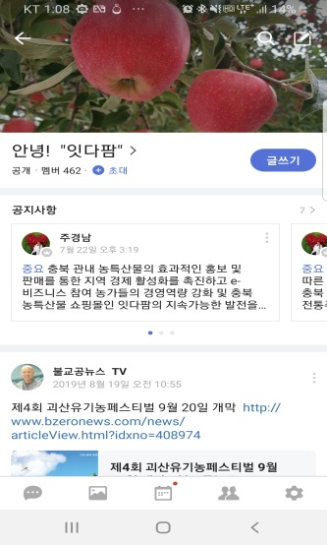
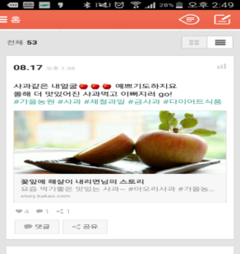
Maximizing PR Effect through Use of Social Media
공유하고 나눌수록 커지는 소셜네트워크

Slide 7
Ⅱ. Background

Slide 8
Ⅱ. Background
Adapt to changing marketing environment due to rapid growth of consumers using smart phones and social media
Need to build a mobile marketplace to share value with consumers
- 98.3% of mobile internet user own smart phones
※ Source: KISA (Korea Internet & Security Agency)

Slide 9
Ⅱ. Background
Share of distribution cost in agricultural management cost increased dramatically since 2000
Need to establish measures to lower promotional expenses at individual farm level
(Unit: KRW 1,000)
※ Source: Statistics Korea

Slide 10
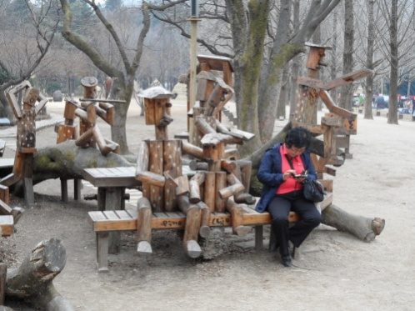
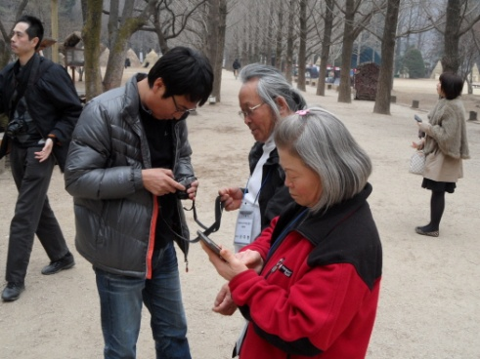
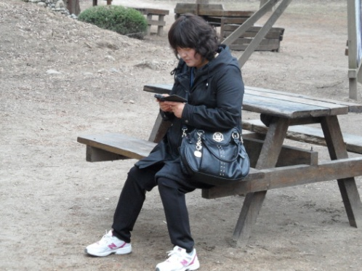
Ⅱ . Background
Farms requested to identify manageable promotion and sales system (May 2013)

Slide 11
Ⅲ. Activities

Slide 12
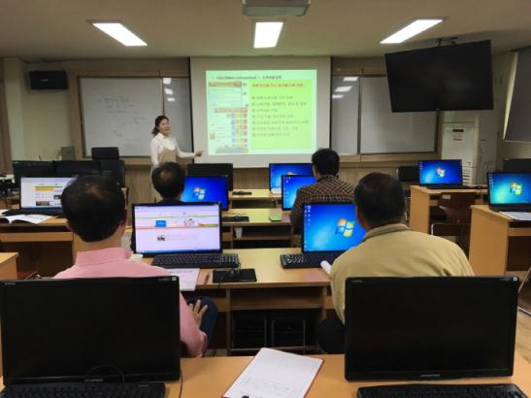
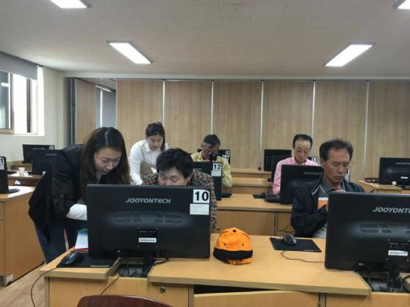
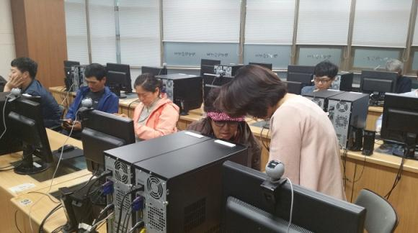
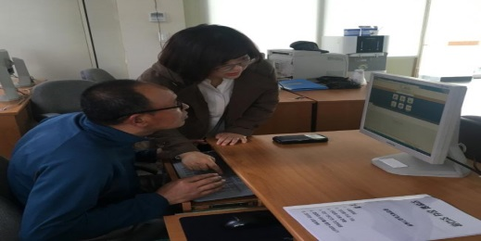
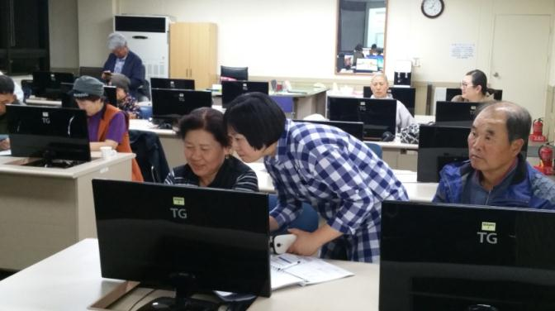
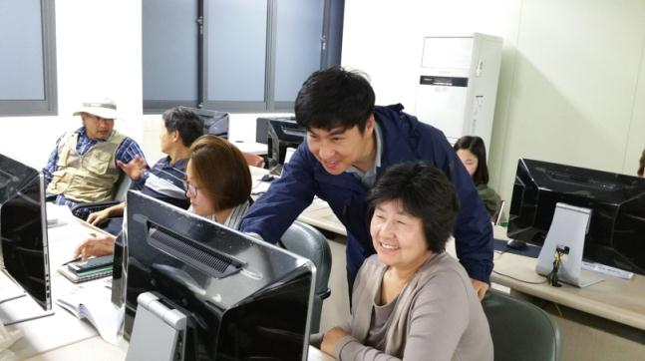
Night Site Training to Maximize Operational Capability for Online Marketplace and Social Media Utilization
Classroom Training: Jan. 21~30, 2015 / 65 farms at 10 locations /
Apr. 14~May 12, 2016 / 119 farms at 10 locations
Training at Farm : Jan. 2015 ~ Present, 92 farms, 60 sessions

Slide 13
Regular Training and Executive Workshop to Enhance Informatization Capacity
Checking improvement measures and practices in mobile shopping mall operation, twice a year from 2015 to 2019

Slide 14
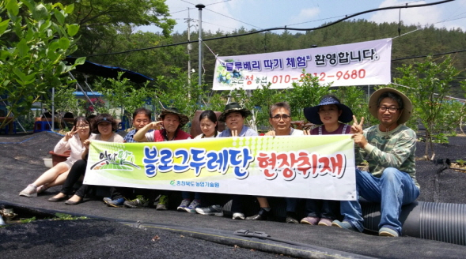
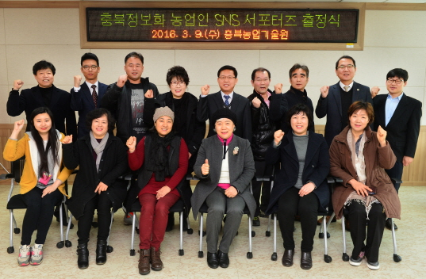
Mobile Market Promotion Activities through Blog Duredan and SNS Supporters
2015-16: Blog Duredan covered 43 farm households and posted 307 times
2018-19: Consumer supporters covered 55 farm households and posted 154 times
420,000 visitors per year

Slide 15
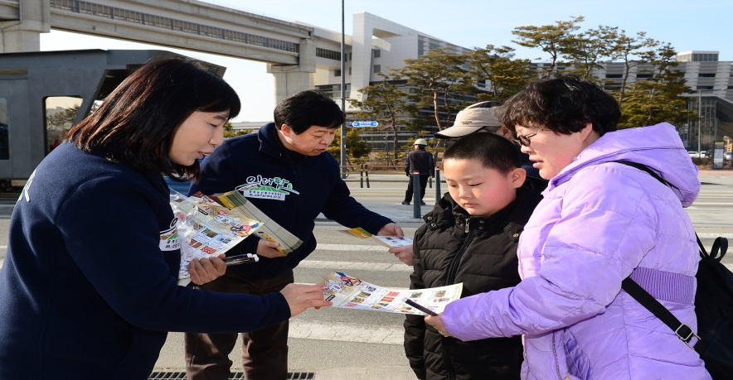
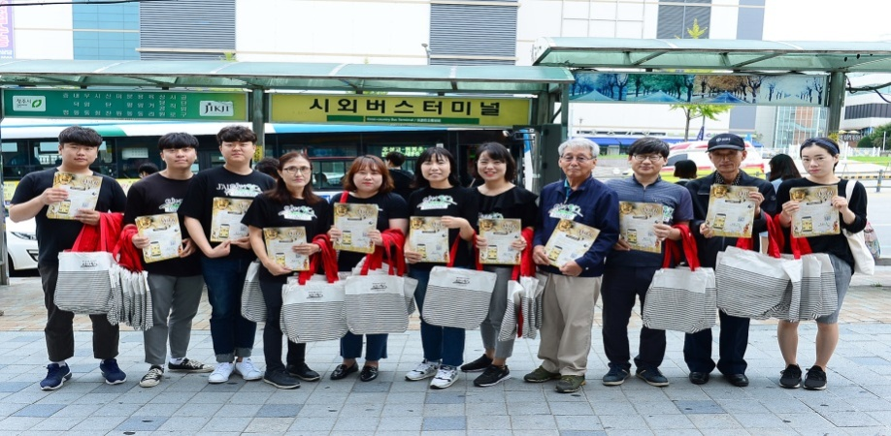
Raising Awareness of Itdafarm through Offline PR Activities
2017-18: Distributed PR leaflets in Public Service Centers at Chungcheongbukdo Provincial Office and nearby governmental agencies, Osong KTX Station and Express Bus Terminal, and Government Complex in Sejong
420,000 visitors per year

Slide 16
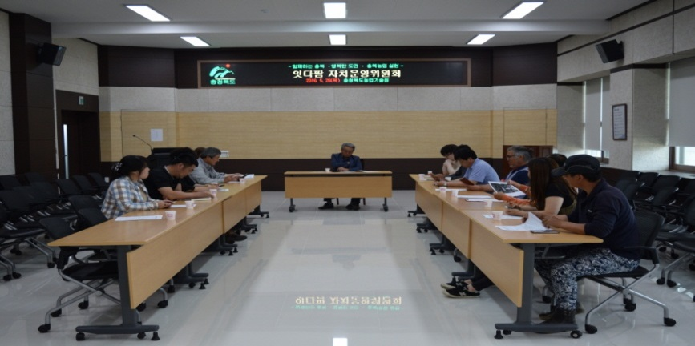
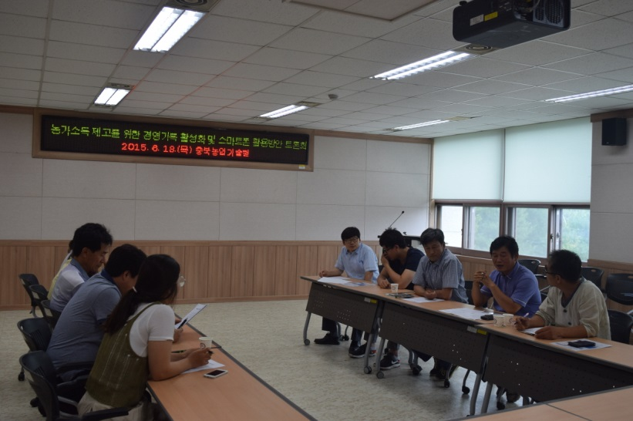
Launched Autonomous Committee for “Itdafarm”Mobile Market
Purpose: Securing self-sufficiency and sustainability in market operation
No. of commissioners: 20 (9 from city and county, 3 from Cheongju)
Established: Thursday, June 18, 2015
Main activities: Discussing market related main agenda incl. mobile market subscription, development plans, etc.

Slide 17
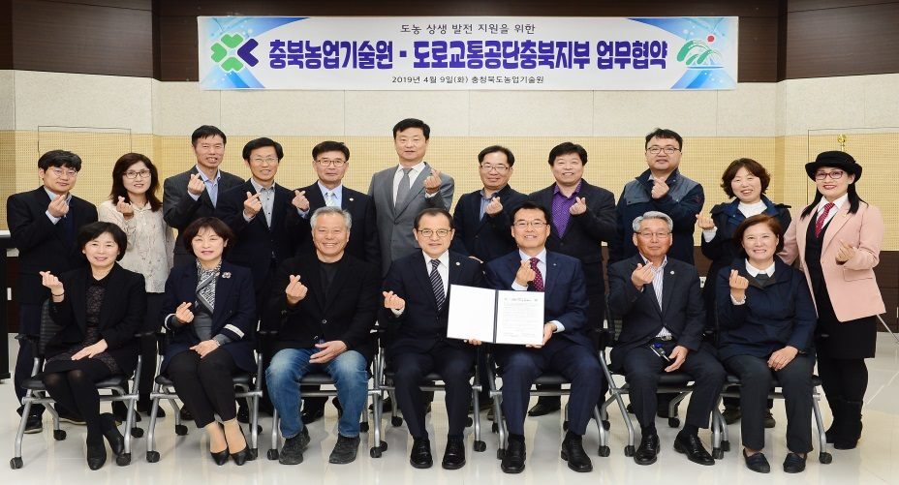
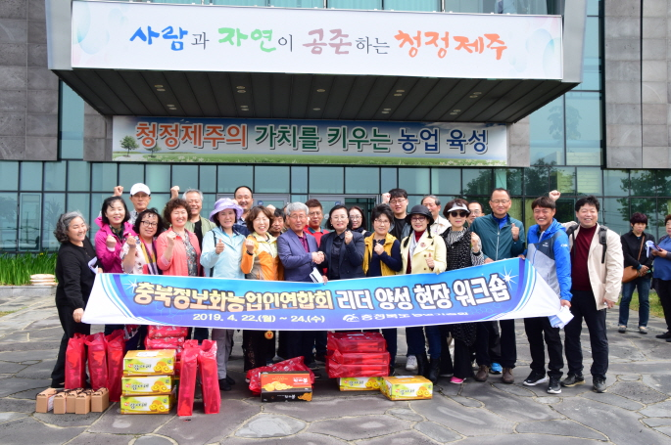
Promoting Win-win Cooperation through Collaboration with Departments and Institutions
Playing Itdafarm PR video and exhibition center at Local Road Traffic Authority & Cheongju Driver’s License Test Center / Business agreement between Chungbuk Farmer’s Information Association and Jeju Farmer’s Information Association
Securing potential customers and encouraging confidence of members

Slide 18
Ⅳ. Challenges and Tasks

Slide 19
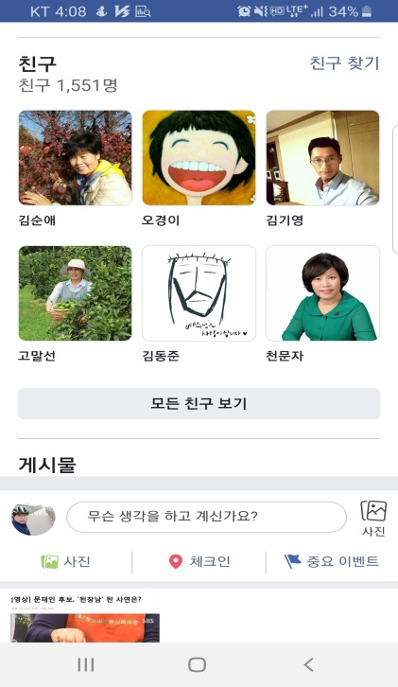
Weakness in Friends Sharing and Collaboration in Social Media
Your client is mine, but my client is mine only!

Slide 20
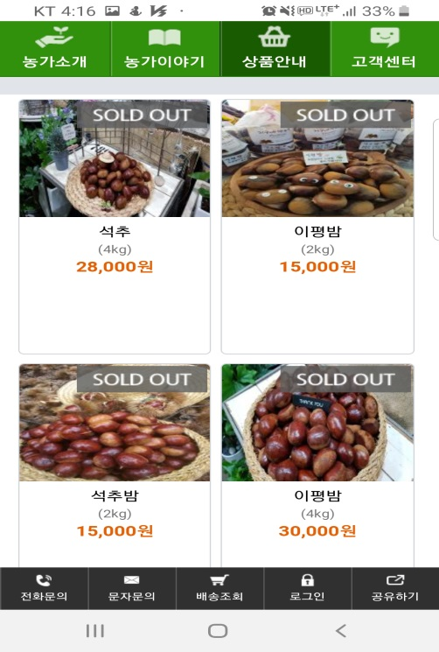
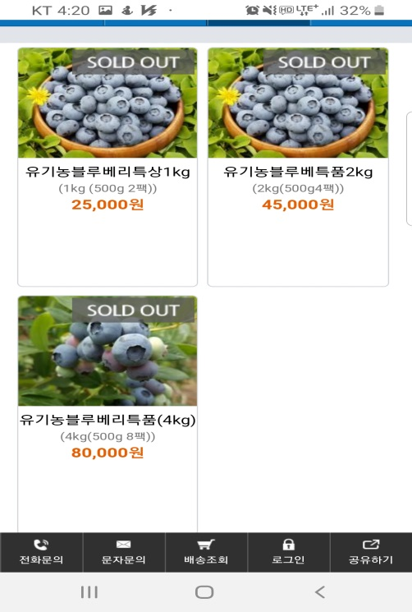
Difficult to Maintain Consistent Product Offering
Decreasing motivation of farmers which lowers operational capability

Slide 21
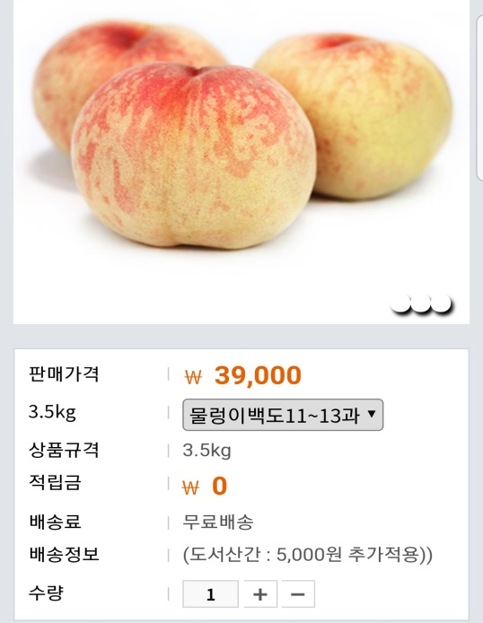
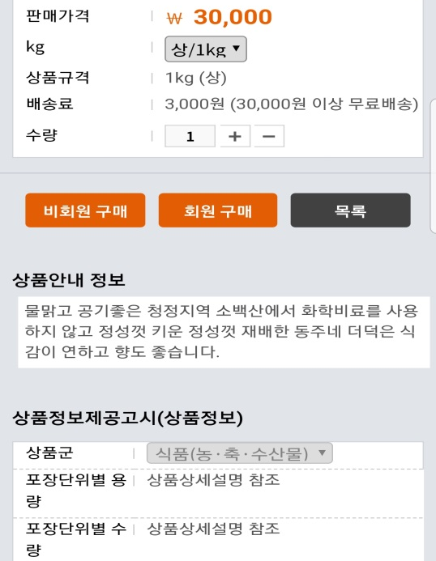
Lack of Attractive Products
Need to hire professional operator or strengthen inhouse operational capability

Slide 22
Thank you for your time and consideration!

